Slide 1
Welcome
2nd annual intercollegiate community engagement institute

Slide 2
Making your Engaged Scholarship Count
Publication Outlets, RT&P Integration
Ross Brooke Watts, Whitworth’s Dornsife Center for Community Engagement

Slide 3
Session Goals
Conceptualize Community Engaged Scholarship (CES)
Review one set of scholarship publication criteria
Review suggestions from a journal editor
Identify publication outlets for CES
Review tools available for portfolio development for RT&P
Review criteria at some universities for CES
Examine some CES items submitted in support of RT&P

Slide 4
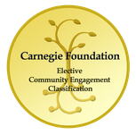
CES Defined
“Community engagement describes the collaboration between higher education institutions and their larger communities (local, national, global) for the mutually beneficial exchange of knowledge and resources in context of partnership and reciprocity.”(Carnegie Foundation, 2007)

Slide 5
Collaboration with different ends
Scholarship, research, creative activity
Democratic values and civic responsibility
Higher Ed knowledge & resources + Public/Private Sector knowledge & resources
Curriculum, teaching, learning
Critical social issues
Educated, engaged citizens
Common good

Slide 6
Outputs defined
Boyer’s Scholarship of Application (Engagement)
Boyer’s other three
Applying knowledge to consequential problems
Source: E. Boyer, Scholarship Reconsidered: Priorities of the Professiorate (Princeton: Carnegie Foundation for the Advancement of Teaching, 1990).
Scholarship of discovery
Contributes to the stock and advancement of knowledge
Scholarship of Integration
Makes connections across disciplines
Scholarship of teaching
Teaching that educated and entices future scholars, stimulates active learning and critical, creative thinking, not only transmits, but transforms knowledge

Slide 7
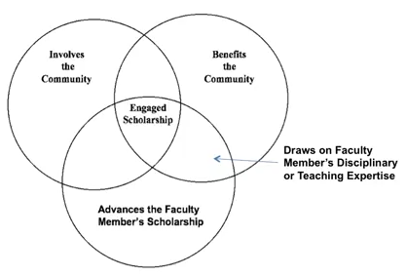
What makes it scholarship? (Howard, 2008)

Slide 8
Getting a Scholarship of Engagement Published
The perspective of Jeff Howard, editor of the Michigan Journal for Community Service Learning

Slide 9
Areas of CES that may be published
Categories are not discrete, but overlap
Scholarship on CE teaching and learning
Writing related to teaching a S-L course
Research on service-learning
Studies of impacts of S-L
Scholarship of engagement
Writing on your involvement in community, benefit to community, your involvement of expertise and scholarly results (with our without students)
Scholarship on engagement

Slide 10
What is within reach? (1)
Scholarship on CE teaching and learning
A case study focused on outcomes
A new model of service-learning within a discipline
An interdisciplinary model
A comparison of outcomes of different models
An innovation in reflection techniques
A self-journey (lessons learned)

Slide 11
Sample article titles
Critical Community Service-Learning: Combining Critical Classroom Pedagogy with Activist Community Placements
Points of Discomfort: Reflections on Power and Partnerships in International Service Learning
Student Perceptions of Community-Based Research Partners and the Politics of Knowledge
Discussion: What might be an article that you might write that relates directly to the study of teaching a S-L course and how would it qualify as scholarship?

Slide 12
What is within reach? (2)
Research on service-learning: a scholarship that examines impacts of S-L on different constituents
Students (academic, civic, motivational, retention, ethical development)
Faculty (motivations, perceived benefits, perceived impediments, faculty development, roles & rewards)
Communities (impacts and partnerships)
Disciplines (varying conceptualizations of community; scholarly benefit)
Institutions (partnerships, institutionalization, strategy, impediments, mission fit)

Slide 13
Sample article titles
College Students’ Negotiation of Privilege in a Community-Based Violence Prevention Program
Negotiating Border Crossing: Influence of Social Identity on Service-Learning Outcomes
The Relationship of Service-Learning and Degree Completion
From Serendipity to Resolve: Graduate Student Motivation to Teach using Service-Learning
Discussion: What might be an article that you might write that relates directly to the research on S-L and how would it qualify as scholarship?

Slide 14
What is within reach? (3)
Scholarship of engagement-involves all four of Howard’s criteria
Could be Community-based research or public scholarship
CBR-research project, co-developed by faculty and community partner, that benefits (a) community and (b) faculty member’s scholarship
Public Scholarship-contributes to public good and yields a product that has public and/or intellectual value (e.g. Imagining America project)

Slide 15
Sample Article titles
Principles for Best Practice in Community-Based Research
A Case-Study of a Community Based Participatory Evaluation Research Project
In your group, describe a way that you could be involved in the community, benefit the community, tap your area of expertise and produce a scholarly product or public artifact?

Slide 16
What is within reach? (4)
Scholarship ON engagement – the investigation of some facet of higher-ed and community partnership

Slide 17
Sample Article Titles
Place-Building Theory: A Framework for Assessing, Advancing and Critically Examining Community Engagement in Higher Ed
The Role of Incentives in Attracting Faculty to Engaged Scholarship
What Influences Long-Term Service-Learning Sustainability: Lessons from Early Adopters
University Leaders Use of Episodic Power to Support Faculty Community Engagement
What might be a topic that you could examine in a scholarly way about some aspect of campus/community engagement, either at your own institution or across similar or different institutions?

Slide 18
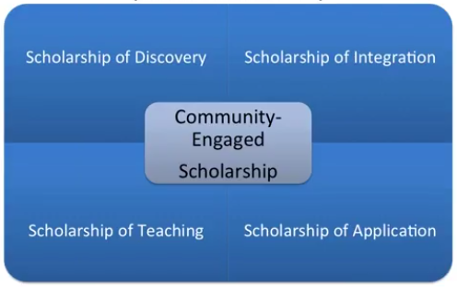
CES is actually broader that Boyer
Implications for RT&P (we will get to this)
Implications for publication venue (think beyond journals mentioned here)
(Crews and Howard, 2008)

Slide 19
Before you publish
Do
Don’t
Articulate your research question and get feedback from colleagues
Align research question, the literature review and methodology (good fit?)
Address CES criteria in your research and writing (check with journal)
Collect good data using rigorous methods
Choose co-authors (include community)
Follow journal’s specified guidelines
Adopt a weak research method
Ignore extant literature
Forget a lay readership especially if including a CP as co-author
Format article weakly (let goals of article inform lit review, method, results and discussion)

Slide 20
As you publish
Do
Don’t
Review recent issues of journals to find a good fit
Follow alignment of an exemplary article (goals inform all content)
Contact editorial board (if allowed) to discuss fit
When asked to “revise and resubmit,” use a cover letter listing all changes made
Conform to journal’s chosen style
Conform content too much (editors want groundbreaking material)
Submit a hot mess
Offer an article that doesn’t fit journal goals
Overlook criteria of scholarship (be literal if need be)
Ignore style guidelines
Write more description than analysis

Slide 21
Where can you publish?
See handout for list of publication outlets.

Slide 22
Who can help?
Visit the excellent site at Fairfield University
http://librarybestbets.fairfield.edu/content.php?pid=565374&sid=4659491

Slide 23
Stand and Stretch
Coming soon: Using CES toward RT&P

