Slide 1
SELF-SWOT:
Thinking Strategically About Ourselves
Dawn Keig
Professor of Strategic Management
Whitworth University

Slide 2
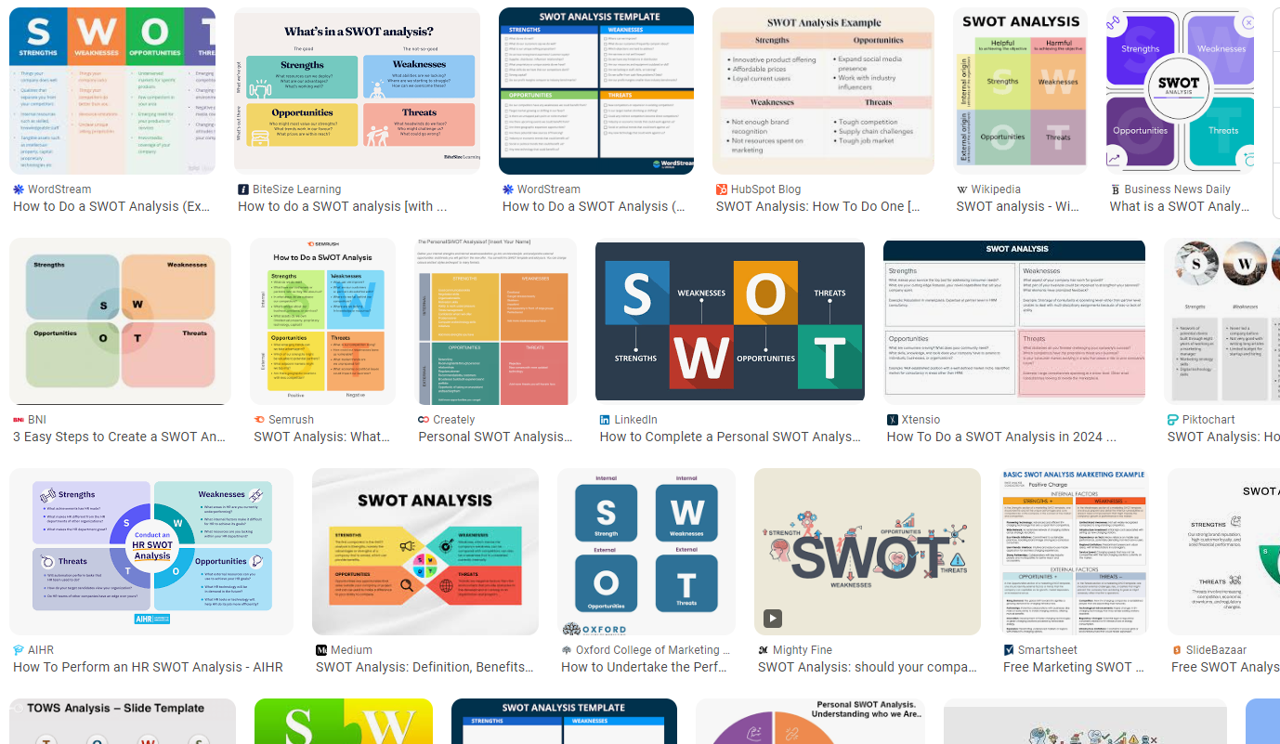

Slide 3
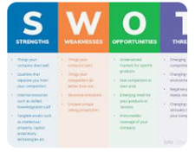
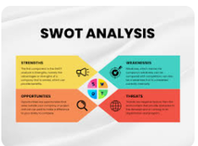
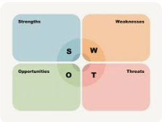
Common SWOT Mistake #1:
A SWOT is not intended to be four separate lists organized randomly
We may brainstorm them letter by letter…
…but there is underlying structure that is critical to recognize for strategic thinking
Structure/format actually MATTERS
X

Slide 4
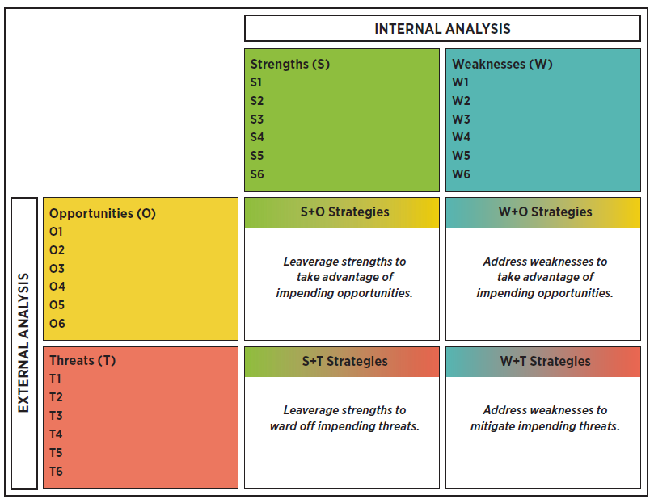
The Internal Perspective:
What do we have to work with?
What do we have to work on?
Strengths
+ (positive)
Weaknesses
- (negative)
Opportunities
+ (positive)
The External Perspective:
What CHANGES are heading our way from our external environment?
competitors
demographics, lifestyle/tastes
technological
economic & regulatory/legislative
Threats
- (negative)

Slide 6
Common SWOT Mistake #2:
“Opportunities” in a SWOT analysis are NOT a place for listing potential actions, new directions or ideas
The word “opportunity” often leads to this kind of list.
“Opportunities” in a SWOT (going back to our structure) are potentially POSITIVE EXTERNAL trends, patterns, changes
Not things they could do
X

Slide 7
Common SWOT Mistake #3:
SWOTs do not end at Analysis
The S-W-O-T lists are not the end, they are the input for idea formulation
SWOT structure allows you to combine one or more SWs with one or more OTs to generate ideas for strategic action that are relevant and actionable.
Or reverse-engineer emergent ideas to see how well they are anchored in internal/external analysis.
X

Slide 9
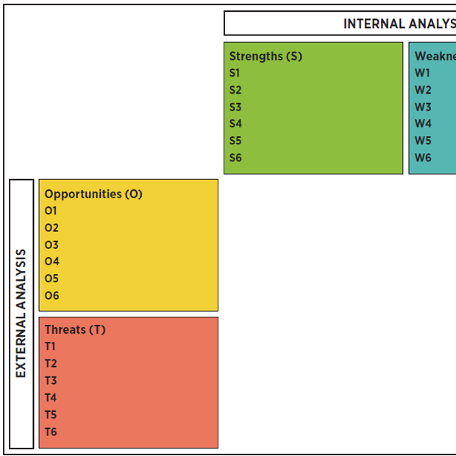
Discussion Checkpoint
How is this approach to SWOT similar to or different from SWOTs you have done/seen in the past?
Do you see any benefits or obstacles to approaching SWOTs in this way?

Slide 10
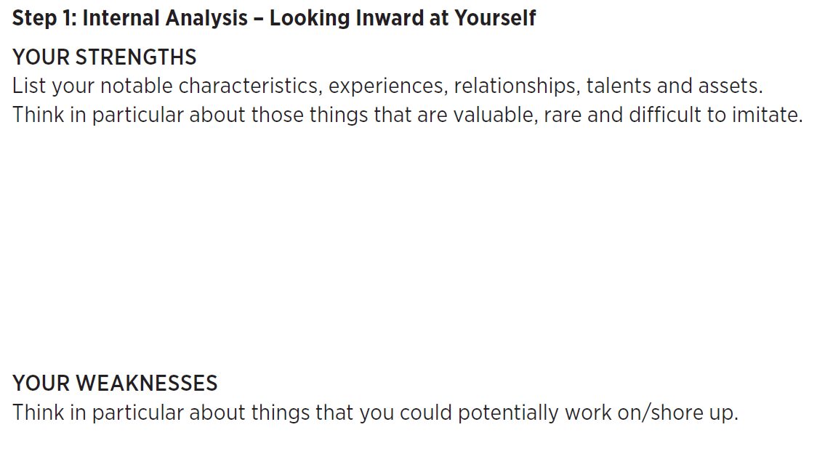

Slide 12
Identify the “formula”, e.g. which specific S-Ws and O-Ts support each specific idea for action.

Slide 13
Final thoughts
Comments
Questions
Takeaways

